Slide 1


Slide 2
US FLAG

Slide 3
CAMP OUTS

Slide 4
CUB SCOUT RANK

Slide 5
SPECIAL SCOUT EVENTS

Slide 6
SCOUT
PREPAREDNESS

Slide 7
CUB FUN

Slide 8
US FLAG
CAMPING
CUB SCOUT RANK
SPECIAL SCOUT EVENTS
SCOUT
PREPAREDNESS
CUB FUN
$100
$100
$100
$100
$100
$100
$200
$200
$200
$200
$200
$200
$300
$300
$300
$300
$300
$300
$400
$400
$400
$400
$400
$400
$500
$500
$500
$500
$500
$500

Slide 9
How many Stripes are on the American Flag?

Slide 10
What is 13

Slide 11
How many stars appear on the US flag?

Slide 12
What is 50

Slide 13
When properly folded, what shape should the folded flag be?

Slide 14
What is a Triangle

Slide 15
What do the 13 strips of the American flag represent?

Slide 16
What is the founding 13 colonies

Slide 17
When a flag is properly folded what should be showing

Slide 18
What are Stars and Blue

Slide 19
A hat is used to protect you from what?

Slide 20
What is the Sun

Slide 21
What would you bring along to alert people if you were lost?

Slide 22
What is a whistle

Slide 23
This has N,S,E, and W on it and help navigate?

Slide 24
What is a Compass

Slide 25
BSA policy states, for any overnight campouts a _____ trained adult leader must be present.

Slide 26
What is a BALOO

Slide 27
True or False, Only a Webelos den may participate in overnight camping without the Pack

Slide 28
True

Slide 29
Which neckerchief is light blue?

Slide 30
What is a Bear

Slide 31
What rank can be described by animals that run in a pack?

Slide 32
What is a Wolf

Slide 33
What cub scout rank starts at Kindergarten grade level?

Slide 34
What are Lions

Slide 35
What does ‘WEBELOS’ stand for?

Slide 36
We'll Be Loyal Scouts

Slide 37
What is the highest cub scout achievement before bridging to Troop?

Slide 38
What is Arrow of Light

Slide 39
What annual event do cub scouts race their homemade cars in?

Slide 40
What is the Pinewood Derby

Slide 41
What do you call an outing with a tents, campfire, fun stories/skits?

Slide 42
What is a Campout

Slide 43
What do you call the event where scouts promote to the next rank?

Slide 44
What is Court of Honor

Slide 45
The event where we collect food for our community

Slide 46
What is Scouting for Food

Slide 47
Every month a pack holds a _____?

Slide 48
What is a Pack Meeting

Slide 49
What is the cub scout ‘motto’ ?

Slide 50
What is Do Your Best!

Slide 51
What should you do if your clothes catch on fire?

Slide 52
What is Stop, Drop, and Roll

Slide 53
This plant is known for its 3 shiny leaf characteristics and can cause uncomfortable itching

Slide 54
What is Poison Ivy

Slide 55
Which knot is a rescue knot?

Slide 56
What is a Bowline

Slide 57
What are the Cub Scout six essentials?

Slide 58
Flashlight
Water bottle
Whistle
First aid
Sun protection
Snack

Slide 59
What color is the cub scout uniform (K-3 grade)

Slide 60
What is Blue

Slide 61
True or False,
The cub scout’s Sign is made with 4 fingers?

Slide 62
What is False

Slide 63
True or False,
I can work on my rank adventures at home?

Slide 64
What is True

Slide 65
Which is better on a hotdog, Ketchup or Mustard?

Slide 66
What is ☺

Slide 67
Which outdoor event did we recently have over 70 people in attendance over the winter?

Slide 68
What is Tubing!

Slide 69
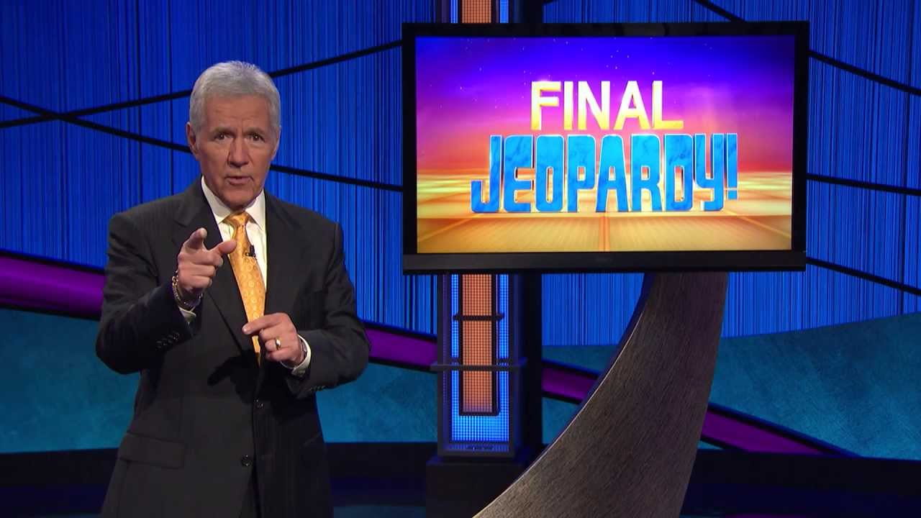

Slide 70
On my honor I will do my best to do my duty to God and my country and to obey the Scout Law; to help other people at all times; to keep myself physically strong, mentally awake, and morally straight…. Is know as the

Slide 71
What is the Scout Oath

